Slide 1
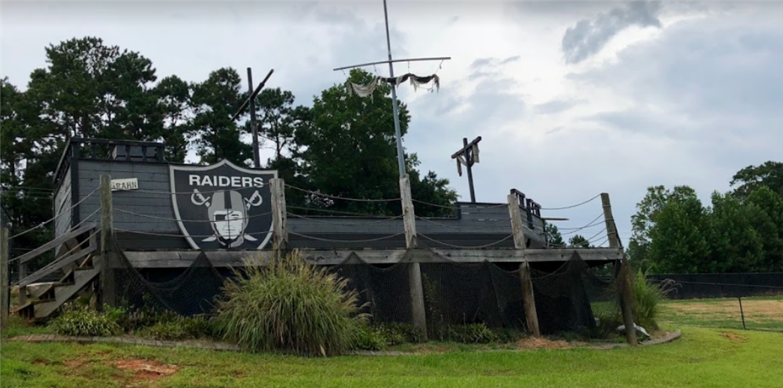
Back to school 2020-2021
Coach Kilday

Slide 2
Ready to get started?
About Me
About this class
Expectations

Slide 3
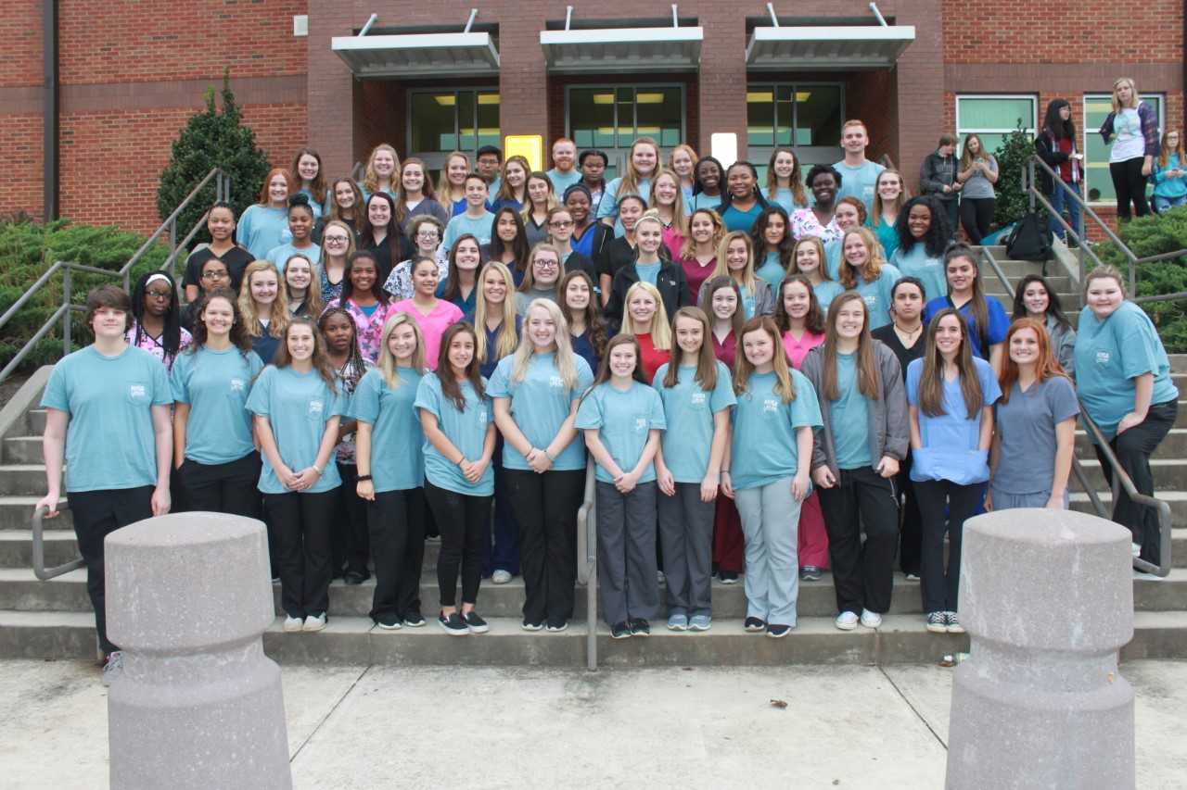
About Me
I have been a teacher at EPHS since 2015
I just had my first baby girl named Peyton
I coach baseball here at EPHS
I worked in the healthcare field at Northside and Saint Joseph’s Hospitals before becoming a teacher
I am the HOSA Advisor for EPHS
When not at school, I love to spend time with my family and to be outdoors
I have a strong passion for creating excellent future healthcare workers
I love all sports and am an Atlanta Braves and Falcons fan
Back to
Ready to get started

Slide 4
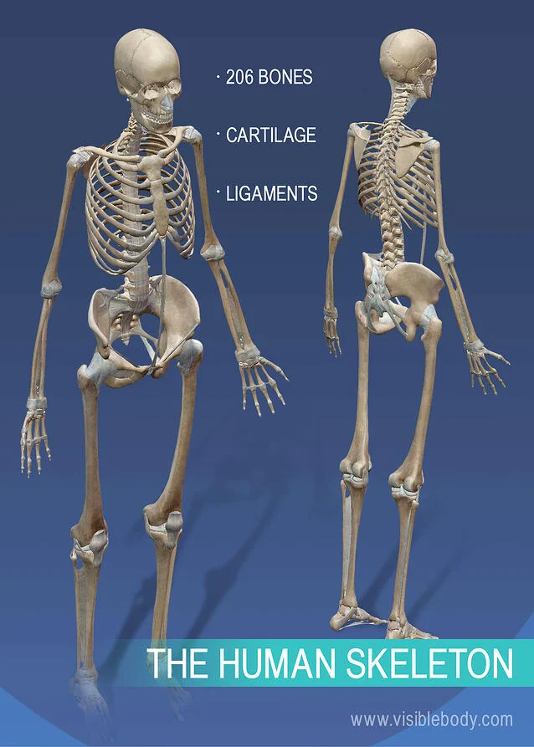
About this class: Essentials to Healthcare
You will need a 1-inch binder with 14 dividers
This class covers Anatomy and Physiology
This class covers diseases associated with each body system
Always bring a positive attitude with you to class
Be prepared to learn about, talk about, and discuss every part of our body
Back to
Ready to get started

Slide 5
Expectations
Be respectful to yourself, your classmates, and your teacher
Be on time and prepared—have pencil, paper and notebook/folder EVERY day
Follow directions the first time they are given
Students may not have phones out during instructional time
Canvas will have all notes taken during digital learning times
Students are responsible for all work missed when absent
Ask questions
TRY YOUR BEST!
Back to
Ready to get started

Slide 6
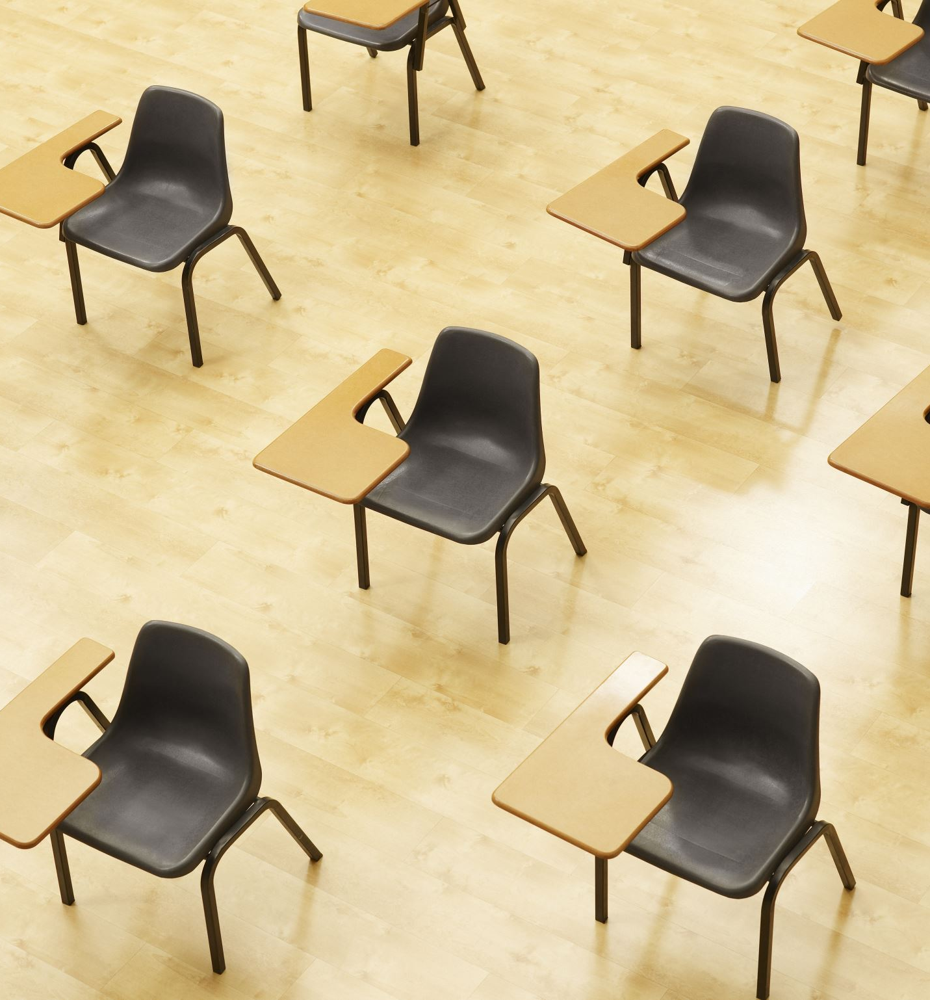
Expectations (cont’d)
Social distancing is expected and will always be enforced in the classroom.
Students are STRONGLY encouraged to wear a mask.
No eating or drinking in the classroom except for breakfast (before school) and during the class assigned lunch time.
Back to
Ready to get started

